Slide 1
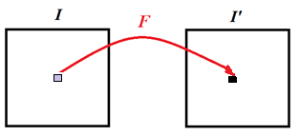
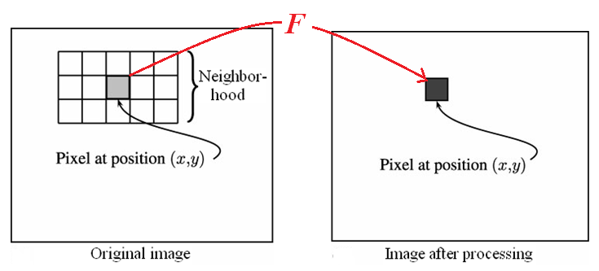
Chapter 5: Neighborhood Processing
Point processing: applies a function to each pixel
Neighborhood processing: applies a function to a
neighborhood of each pixel
5-<number>

Slide 2
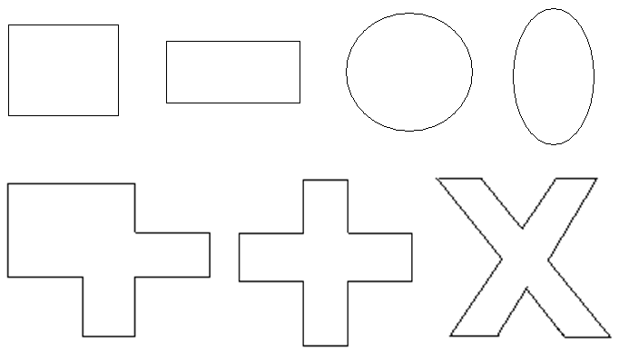
○ Neighborhood (mask) can have
Different shapes
Different sizes
5-<number>
Notes:
對每個mask定義參考點,通常是中間(其他地方也可以,也可以定到外面)

Slide 3

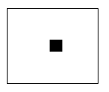

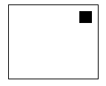
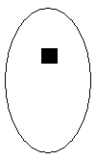

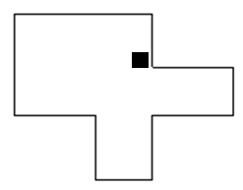
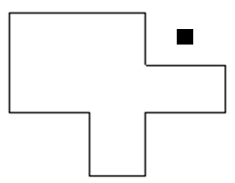

○ Define a reference point of a mask
5-<number>

Slide 4
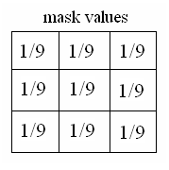
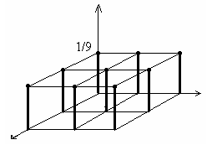

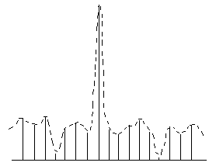

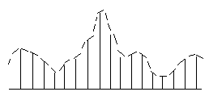

○ Mask + Function = Filter
2-D:
1-D:
Example:
Input signal
Filter
Output signal
5-<number>
Notes:
filter-用於noise removal或是smoothe(圖中兩種filter皆如此)

Slide 5
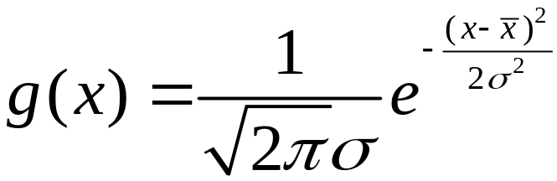
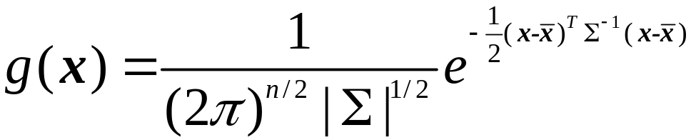
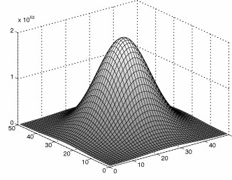
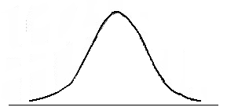
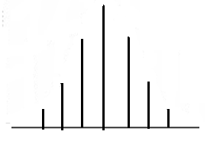
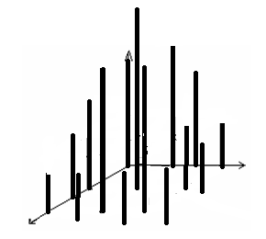
1D
2D
Continuous
Discrete
5-<number>
Notes:
continuous 值加起來=1
discrete 值加起來<1->要用normalization使加起來=1(除以他加起來的值)

Slide 6
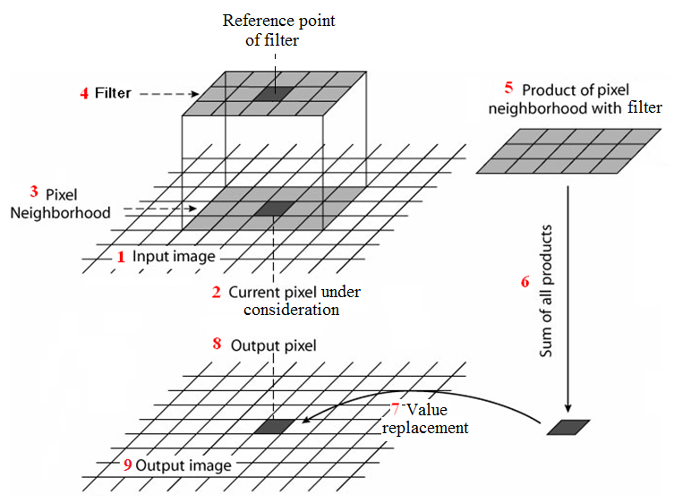
◎ Linear filter: linear combination of the gray
values in the mask
5-<number>
Notes:
黑色-reference point
filter中的值相加=1

Slide 7
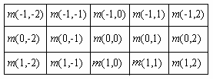
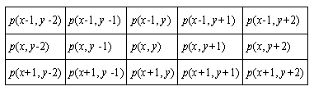
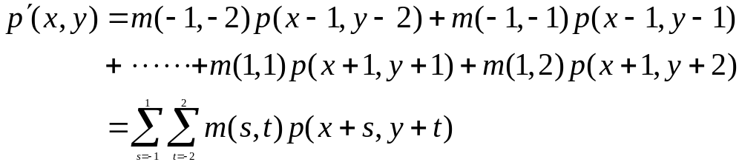
Mask
values
Pixel
values
5-<number>

Slide 8
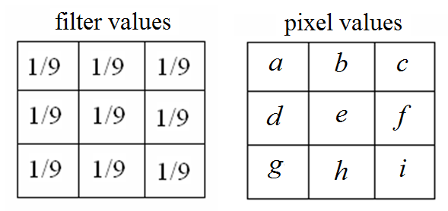
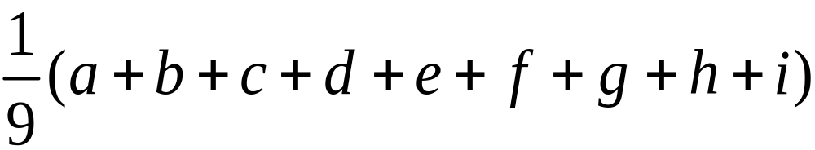
。 Example
5-<number>

Slide 9
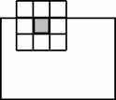
○ Processing near image boundaries
Ignore the boundary
Pad with zeros
(c) Copy boundary
○ Values outside the range 0-255
Clip values
Scale values
5-<number>

Slide 10
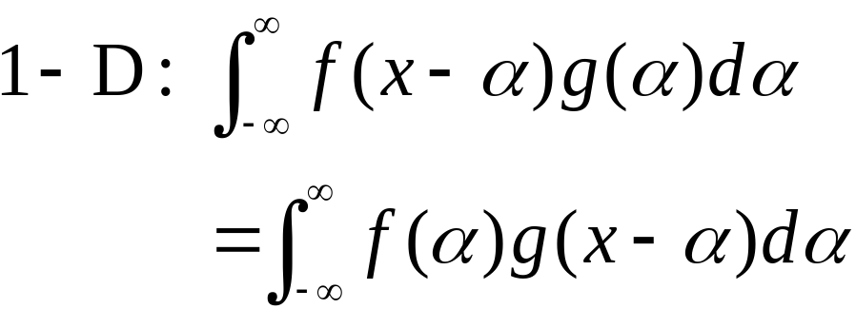
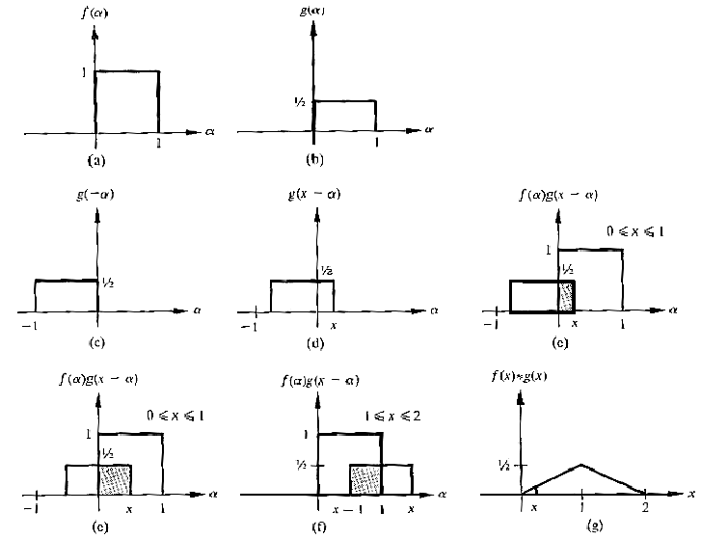
◎ Convolution
5-<number>
Notes:
翻轉(reverse)
移動(move)
計算重疊面積

Slide 11
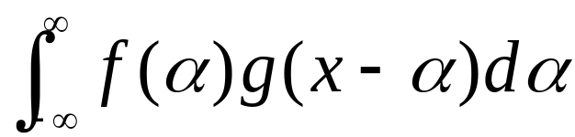




Summarize the process of convolution
1. Traverse
2. Move from
3. Calculate and record the overlapping
area between at every
point.
5-<number>

Slide 12
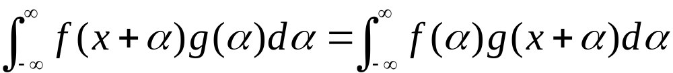
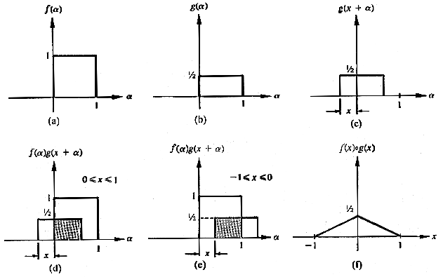
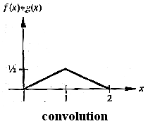
◎ Correlation
5-<number>

Slide 13
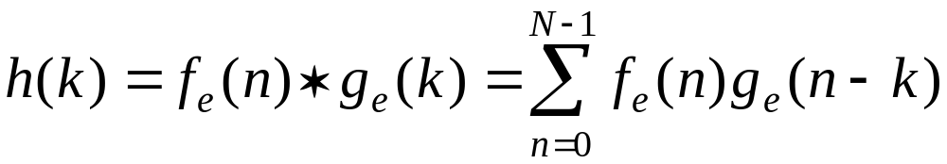
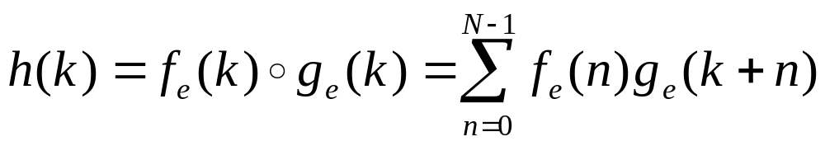

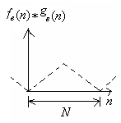
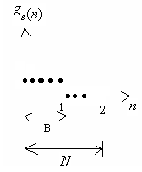

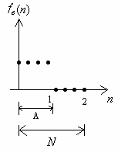



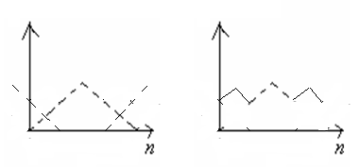

N>8:
。 Discrete Case:
e.g.,
A = 4, B = 5, A + B – 1 = 8,
7-<number>
Notes:
o是什麼符號?
h(k)???

Slide 14

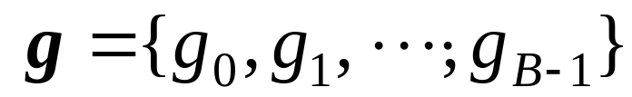
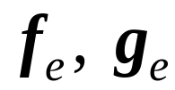

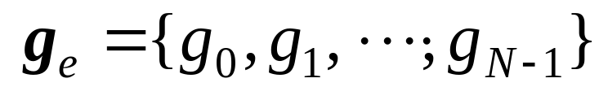

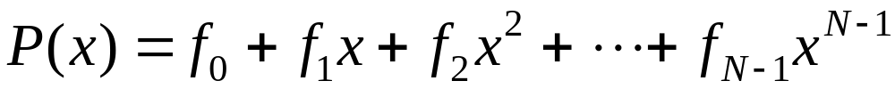
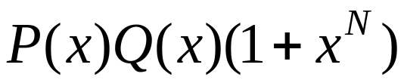
＊ Convolution can be defined in terms of
polynomial product
Extend f, g to
Let
Compute
7-12

Slide 15

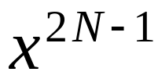




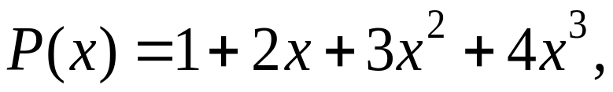
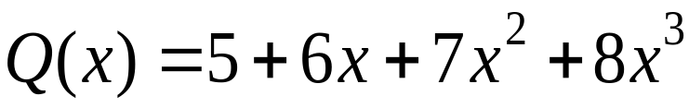
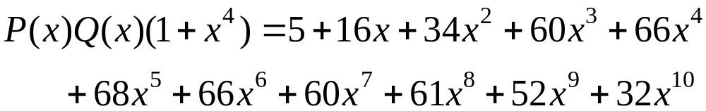

The coefficients of to form the result
of convolution
。 Example:
Let
7-13

Slide 16
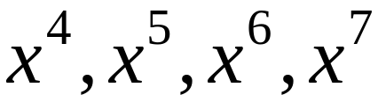

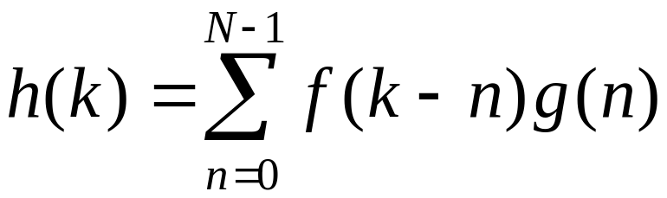
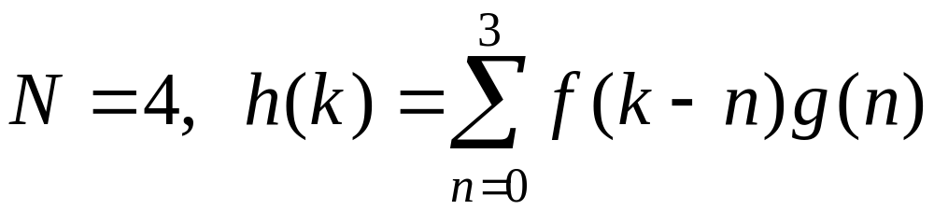
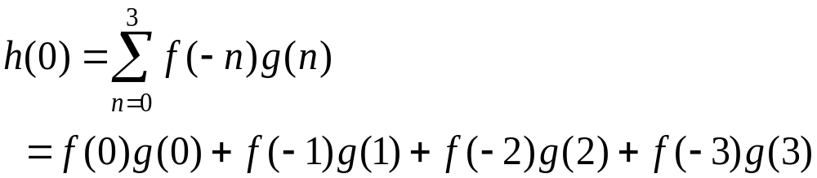
The coefficients of form the
convolution
7-<number>

Slide 17


7-<number>

Slide 18



Discrete:
Compared with
Linear filtering:
7-<number>

Slide 19




○ Separable filters
e.g.,
。 Example:
Laplacian
filter
5-<number>
Notes:
Laplacian filter-用於 detect edge

Slide 20




n × n filter:
2 (n × 1) filters:
5-<number>

Slide 21






◎ Smoothing Filters
○ Averaging
filters
Input 3X3 5X5 7X7
5-<number>

Slide 22



○ Gaussian filters
(1-D):
(2-D):
5-<number>
Notes:
gaussian 自己權重較高,不容易被改
average 容易受旁邊影響

Slide 23








Averaging filters
Gaussian filters
5-<number>

Slide 24


Frequency domain filters
Spatial filters applied to
spatial domain (image)
Frequency filters applied to frequency domain (Fourier transform of image)
Intensity image
(spatial domain)
Fourier transform
(frequency domain)
5-<number>
Notes:
image transform不等於tramsformation
image transform(n,v)-一種空間轉到另一種空間(ex:Fourier transform)
可能某性質在某空間中無法顯露出來,故轉換到另一空間才可觀察
transformation-rotate、move、scale

Slide 25



Fourier Transform (FT)
Fourier Transform of function f(x)
Inverse Fourier Transform of F(u)
Discrete FT
5-<number>

Slide 26




Example:
5-<number>

Slide 27




2-D Fourier Transform
Fourier Transform of function f(x, y)
Inverse Fourier Transform of F(u, v)
Discrete
FT
5-<number>

Slide 28


5-<number>

Slide 29






High pass filter
Frequency filters
High frequency components, e.g., edges, noises
Low frequency components, e.g., regions
Spatial
domain
Fourier
transform
Frequency
domain
Low pass
filter
5-<number>
Notes:
average/gaussian filter-把edge、noise模糊(故為low pass filter)
high pass filter-high light edge、noise

Slide 30


High pass
Input image
Fourier transform
Low pass
5-<number>

Slide 31




5-<number>
Notes:
low pass把影像smoothe掉(edge、noise)

Slide 32


◎ Convolution theorem:
Convolution:
* : convolution
◎ Correlation theorem
Correlation:
* : conjugate
7-<number>

Slide 33


◎ Edge Sharpening or Enhancement
○ Unsharp masking
5-<number>

Slide 34

。 Idea of unsharp masking
(a) Edge
(b) Blurred edge
(a) – k × (b)
5-<number>

Slide 35


。 Perform using a filter
e.g., k = 0.9
5-<number>

Slide 36


。 Alternatives
(a)
(b) The averaging filter can be replaced
with any low pass filters
5-<number>

Slide 37

。 Example:
(a) Original (b) Unsharp Masking
5-<number>

Slide 38

。 Alternatives:
i) (k/(k-1))(original) + (1/(k-1))(low pass)
ii) (k/(2k-1))(original) +
((1-k)/(2k-1))(low pass)
5-<number>

Slide 39

。 Example:
(a) (k/(k-1))(original) + (1/(k-1))((low pass)
(b) (k/(2k-1))(original) +
((1-k)/(2k-1))((low pass)
5-<number>

Slide 40







◎ Non-linear smoothing filters
Maximum filter:
: mask elements
Minimum filter:
5-<number>

Slide 41




。 Median filter
noise removal
edge preserving
。 K-nearest neighbors (K-NN)
5-<number>

Slide 42


。 Geometric mean filter
。 Alpha-trimmed mean filter
i) Order elements
ii) Trim off m end elements
iii) Take mean
5-<number>
Notes:
trim 修剪

Slide 43





◎ Region of Interest Processing
5-<number>

Slide 44
問題
一、p13:o是什麼符號?
二、p13:h(k)???
5-<number>

